Slide 1

Face Exit Animation Template
Use the Offset X and Offset Y on the crop settings of the image to change the face.
To use this animation, copy and paste the nice job image to a duplicate of the slide to transition from. Then set the auto transition of the duplicated slide to the length of the animation of the image.

Slide 2
Face Entry Animation Template
Use the Offset X and Offset Y on the crop settings of the image to change the face.
To use this animation, copy and paste the nice job image to the slide.
The image is hidden on this slide so that you can read this.

Slide 3
Mandatory Slides for 10-20-30
[Conrad] Additional presentation artwork
Title Page [0.5]
[Caleb] [1.5] Problem / Opportunity (push – up)
[Caleb] [1.5] Value Proposition (push - right)
[Caleb] [5] Underlying Magic (face – nice job)
[Jon] [1.5] Business Model (push - up)
[Jon] [1.5] Go To Market Plan (push - right)
[Jon] [1] Competitive Analysis (face - wowza)
[Conrad] [1] Management Team (Morph)
[Zeki] [3] Financial Projections and Key Metrics (face)
[Zeki] [2] Current Status, Accomplishments to Date, Time Management and Use of Funds (face)

Slide 4





















Slide 5


Slide 6


Construction Chaos
Caleb Griffin
Jon Fieldhouse
Conrad Smith
Craig Zeki

Slide 7


An Opportunity
2013
$61 billion market value
300 indie games
5 million concurrent players
2023
$245.1 billion market value
>1000 indie games
>26 million concurrent players

Slide 8


Our Value Proposition
Our Sub-Genre:
Our Gameplay Features:
Group Objective
Individual Tasks
The Group Objective must be completed
Sub-Genres:
Competition
Coop-etition
Cooperation

Slide 9
Our Value Proposition
Our Sub-Genre:
Our Gameplay Features:
Group Objective
Individual Tasks
The Group Objective must be completed
Coop-etition

Slide 10
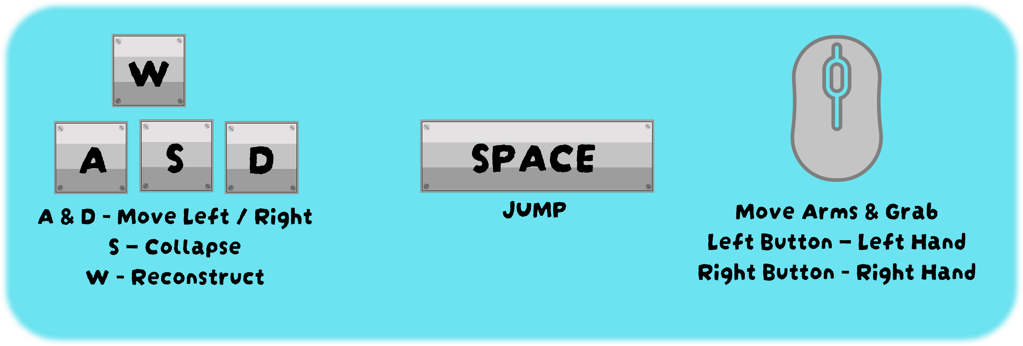
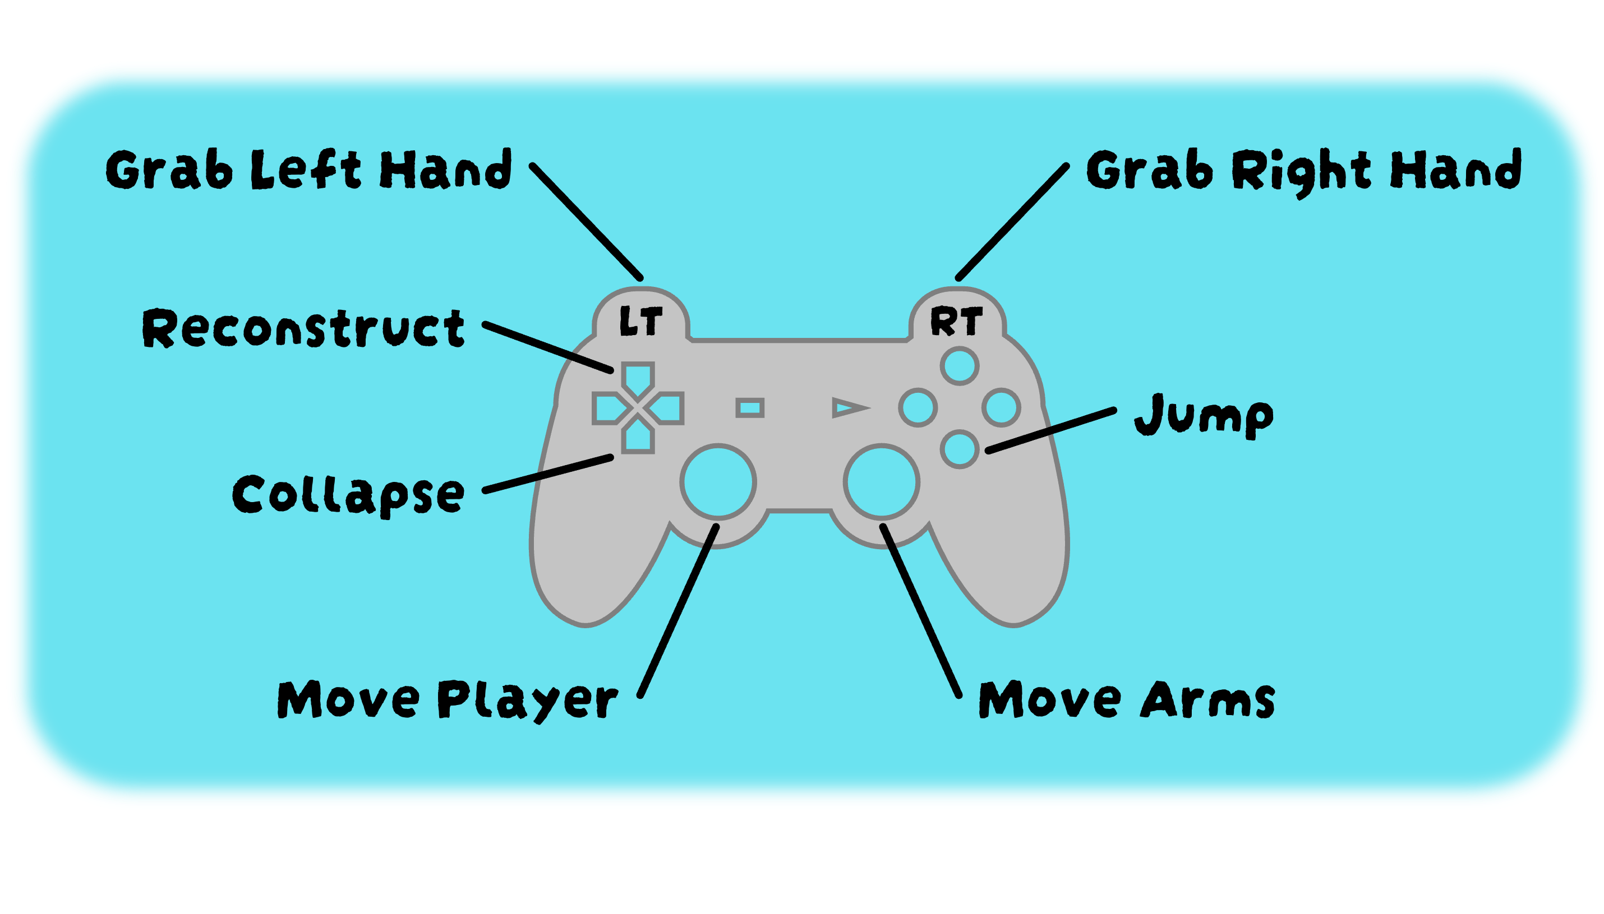
Underlying Magic

Slide 11
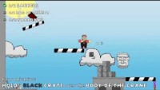
Backup Video

Slide 12
Community Feedback
“Kept me entertained for a few hours.”
“10/10, would dab on a construction site again.”
trashcanking
“The game completely matches its name! It is truly total chaos.”
Tanipup

Slide 13

Our Business Model
Market the game at a fixed price
No Ads
No Ads to distract from the theme and experience
Engage with the players and build a community for the game
Roll out content/updates regularly to maintain interest
Competitively priced at £6
Explore alternative sources of revenue, like merchandise
Scalability of software architecture means we can create other Chaos titles (Kitchen Chaos, Countryside Chaos, etc...)

Slide 14



Go-To-Market
Target key demographics identified within a few major advertising platforms
Promotional content carefully created to maximize engagement on each platform
Instagram hosts the largest demographic of 24-35 year olds
Content will also highlight mechanics and features to entice
Players will be directed towards the itch.io page where they can download the game, right now!
Twitter’s largest demographic is made up of 18-34 year olds
Collaborate with other creators who's audience might be interested
Additionally, 67% of the user base are 18-24 years old

Slide 15

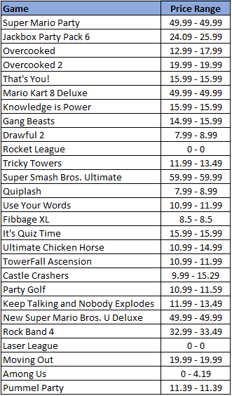
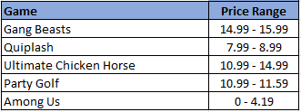

Competitive Analysis
Research shows other games of this ilk are typically more expensive
Prices range from £0-£59.99
From this analysis, we selected a handful games we thought fill a similar niche to base our price on
Here, prices range from £0-15.99
This game offers great value, multiplayer fun for everyone
The price can even increase slightly as more content is added to the game over time
With each expansion, the franchise will grow in value

Slide 16




Management Team
Lead Developer
Craig Zeki
Developer
Caleb Griffin
Chief of Social
Media & Marketing
Jon Fieldhouse
Head of Art
Conrad Smith
Notes:
Craig, our skilled lead developer, leads our development efforts with precision and ingenuity. With a remarkable ability to guide teams, his expertise in C# and Unity development empowers us to create innovative and immersive gaming experiences that captivate our audience.
Caleb, our experienced developer, possesses a wealth of expertise in game development across various platforms. With a strong educational background and a proven track record in delivering high-quality projects, Caleb's technical prowess and dedication to perfection ensure that our games are top-notch.
Conrad, our talented lead artist, has a keen eye for aesthetics and an uncanny ability to bring ideas to life. With a mastery of pixel art and concept development, Conrad's artistic vision and attention to detail ensure that our games are visually stunning and captivating.
Jon, our marketing lead, may be new to the marketing field but brings invaluable expertise in game development and a collaborative mindset to the table. Jon's commitment to excellence, coupled with his dedication to learning, allows us to devise effective marketing strategies that resonate with our target audience.

Slide 17
Management Team
Lead Developer
Craig Zeki
Developer
Caleb Griffin
Chief of Social
Media & Marketing
Jon Fieldhouse
Head of Art
Conrad Smith
Notes:
Craig, our skilled lead developer, leads our development efforts with precision and ingenuity. With a remarkable ability to guide teams, his expertise in C# and Unity development empowers us to create innovative and immersive gaming experiences that captivate our audience.
Caleb, our experienced developer, possesses a wealth of expertise in game development across various platforms. With a strong educational background and a proven track record in delivering high-quality projects, Caleb's technical prowess and dedication to perfection ensure that our games are top-notch.
Conrad, our talented lead artist, has a keen eye for aesthetics and an uncanny ability to bring ideas to life. With a mastery of pixel art and concept development, Conrad's artistic vision and attention to detail ensure that our games are visually stunning and captivating.
Jon, our marketing lead, may be new to the marketing field but brings invaluable expertise in game development and a collaborative mindset to the table. Jon's commitment to excellence, coupled with his dedication to learning, allows us to devise effective marketing strategies that resonate with our target audience.

Slide 18
Financial Projections - Revenue
Target Audience Calculation
10%
Estimated Target Audience Captured
73.6%
Play Casual Multiplayer Games
1,700,000,000
0.5%
Interested in Construction Chaos (conservative)
Based on
£6 per unit
56%
Play Multiplayer
952,000,000
700,672,000
3,503,360
350,336
**Based on a survey of "Most played types of games among gaming audiences in selected countries as of January 2021“ (Statistica, 2021)

Slide 19


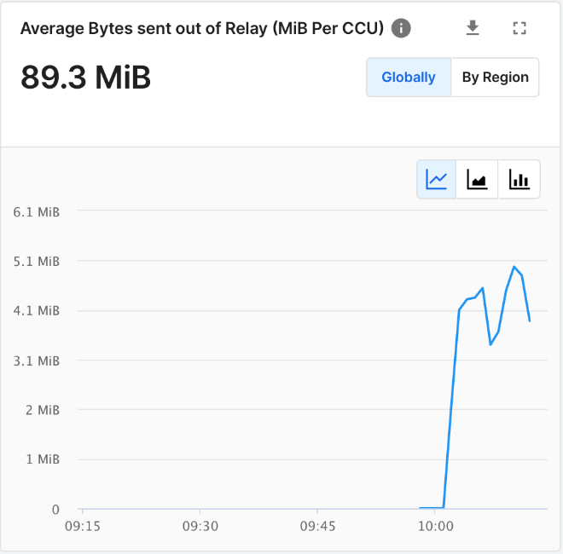


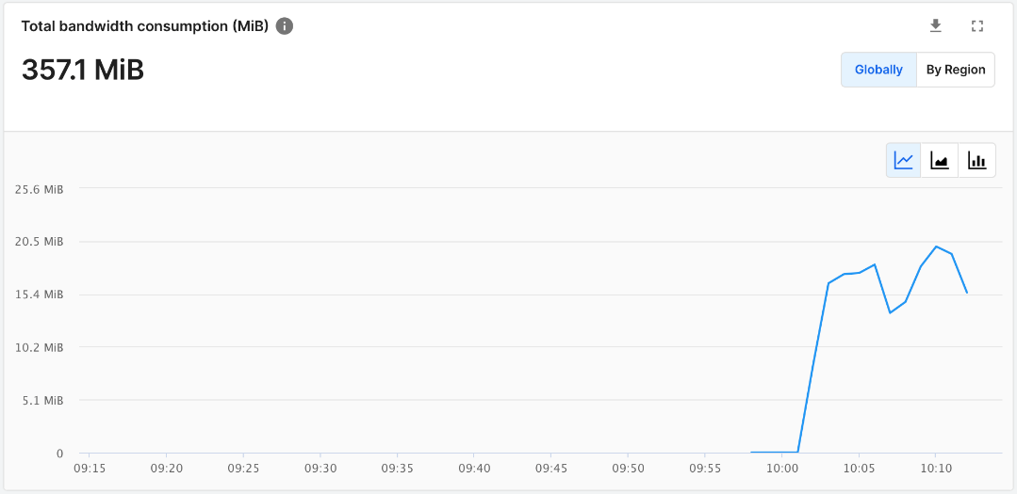
Financial Projections - Costs
OUT NOW!
Construction Chaos
Setup Costs: £6,100
Advertisement: £135
Per week – 25K Impressions
Ongoing Maintenance
582 hrs / yr - £14,550
Development PCs: £6,000
Itch.io fee = 5%
Development Costs: £52,344
Play data for 10min, 4 player session
Extrapolated yearly network usage
Asset purchases: £100
Unity Relay Costs: £varied
Planning: 269 hours
Concept: 627 hours
Itch.io Costs: £varied
Production: 896 hours
Adv. Costs: £135 p/wk
Maintenance: £14,550 p/yr
Testing: 627 hours
Total: 2420 hours

Slide 20
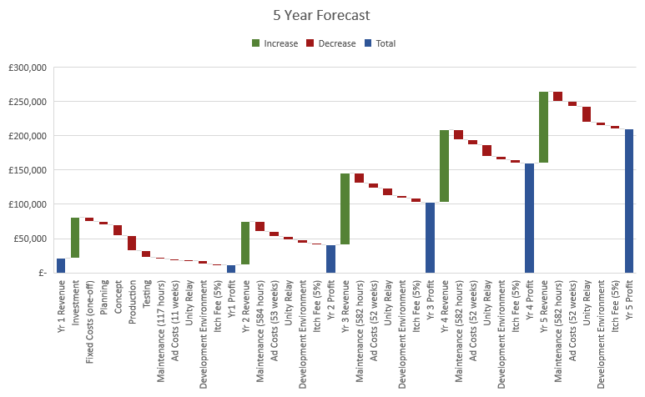
Financial Projections - Investment
Total Investor Profit Share
£210,122 – ROI 350%
(£152,122 after initial investment)

Slide 21





Roadmap to Success
Successful Release
Custom Art
Software Architecture and
Code Documentation
Strong Foundations
Custom Tools
Dedicated Team

Slide 22


Roadmap to Success
Growing
Social Media Presence
Growing Community
Strong Foundations
113
47
Views
Downloads

Slide 23
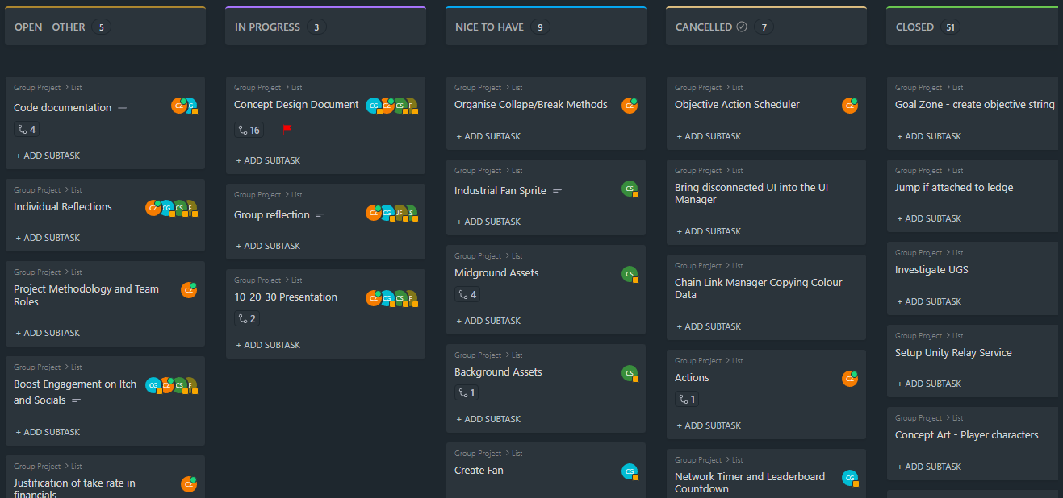
Roadmap to Success
Achievable Timeline
Achievable Timeline
Growing Community
Data Driven
Agile Kanban
Strong Foundations

Slide 24
Roadmap to Success
Achievable Timeline
Achievable Timeline
Growing Community
Data Driven
Agile Kanban
Strong Foundations

Slide 25
Roadmap to Success
Achievable Timeline
Achievable Timeline
Growing Community
Data Driven
Agile Kanban
Strong Foundations

Slide 26
Roadmap to Success
Achievable Timeline
Achievable Timeline
Growing Community
Data Driven
Agile Kanban
Strong Foundations

Slide 27
Roadmap to Success
Achievable Timeline
Achievable Timeline
Growing Community
Data Driven
Agile Kanban
Strong Foundations

Slide 28
Roadmap to Success
New Features!
Exciting Feature Plan
Achievable Timeline
Growing Community
Strong Foundations
And many more...

Slide 29
Roadmap to Success
Exciting Feature Plan
Achievable Timeline
Growing Community
Strong Foundations

Slide 30
Let’s Go!
Any Questions?

Slide 31
References:
Statistica (2021). Favorite video game types worldwide 2021 | Statista. [online] Statista. Available at: https://www.statista.com/statistics/371020/consumer-preferred-video-game-types/ [Accessed 6 Jun. 2023].

